Slide 1
ReactJS

Slide 2
Table of Contents
Introduction
Virtual DOM
JSX
Setup
Components
State and props
Component Lifecycle
Events
Conditional Rendering
List and Keys
React Forms
Fetch API
Router
Lifting up state
Composition

Slide 3
Introduction
ReactJS is simply a JavaScript library developed at Facebook to facilitate the creation of interactive, stateful & reusable UI components.
It highly performant and renders changes almost instantly.
It is used at Facebook in production, and Instagram.com is written entirely in React.

Slide 4
Advantages of Reactjs
JSX is a JS syntax that enables HTML quotes and usage of HTML tag syntax for subcomponents rendering. It promotes building of machine-readable code and provides ability to compound components in one compile-time verified file.
Prompt rendering is among the best features of React that gives a significant edge over Angular. The technology comprises smart methods to mitigate the amount of DOM operations, optimize and accelerate the updates process. Virtual DOM (Document Object Model) is of great use while handling vast databases.
The core difference between reactjs and angularjs is that React is JS-centric, while ng2 remains HTML-centric. JavaScript is far more robust, than HTML, that makes React far more simple, focused and consistent.

Slide 5
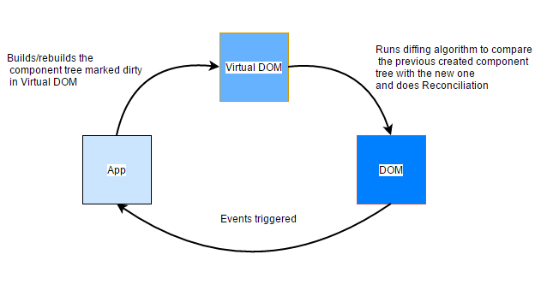
Virtual DOM
The virtual DOM is an in-memory representation of the real DOM elements generated by React components before any changes are made to the page.

Slide 6
The steps that happen between the render function being called and the displaying of elements on the screen are,
Create a VDOM with a new state
Compare it with older VDOM using diffing.
Update only differ nodes in real DOM.
Assign new VDOM as older VDOM.

Slide 7
JSX - javascript XML syntax transform. It helps in making our writing code easier and faster. JSX lets us writeHTML (not 100%) with XML based object representation.
JSX

Slide 8
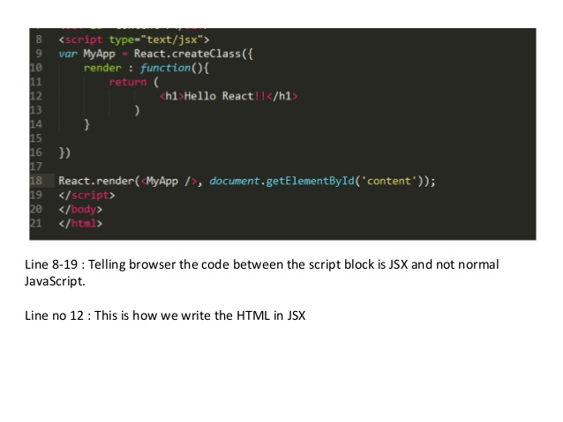
Line 8-19 : Telling browser the code between the script block is JSX and not normal JavaScript. Line no 12 : This is how we write the HTML in JSX
Line 8-19 : Telling browser the code between the script block is JSX and not normal JavaScript.
Line no 12 : This is how we write the HTML in JSX

Slide 9
Setup
Creating a New React Project
It is recommended to use create-react-app to create a new project because it saves you from the hassle of configuring WebPack and lets you quickly generate a starter project to build your app.

Slide 10
Installing create-react-app
You can use npm to install create-react-app with the following command:
npm install -g create-react-app
Generating a New React Project
Now, The new project can be generated by running the following commands:
create-react-app sample_demo cd sample_demo npm start

Slide 11
Components let you split the UI into independent, reusable pieces.
Conceptually, components are like JavaScript functions. They accept arbitrary inputs (called “props”) and return React elements describing what should appear on the screen.
Components

Slide 12
Using ES6 class:
class Welcome extends React.Component { render() { return <h1>Hello, {this.props.name}</h1>; } }
Using JS function:
function Welcome(props) { return <h1>Hello, {props.name}</h1>; }
Demo: https://codepen.io/Naveen2507/pen/ZMJORv

Slide 13
State
State of a component is an object that holds some information that may change over the lifetime of the component

Slide 14
To define a state of any Class we can use the sample format below.
Class MyClass extends React.Component {
constructor(props){
super(props);
This.state = { attribute: “value”};
}
Demo: https://codepen.io/nataliyajurbenko/pen/JpJgmE

Slide 15
Props
Props are similar to arguments for pure functions argument.
Props of component are passed from parent component which invokes component.
Props in a component cannot be modified(Immutable).
Demo: https://codepen.io/Kiwka/pen/YrYdyR
https://codepen.io/Naveen2507/pen/ZMJORv

Slide 16
Component life cycle
Every React Component has a lifecycle of its own, lifecycle of a component can be defined as the series of methods that are invoked in different stages of the component’s existence.

Slide 17
A React Component can go through four stages of its life as follows.
Initialization: This is the stage where the component is constructed with the given Props and default state. This is done in the constructor of a Component Class.
Mounting: Mounting is the stage of rendering the JSX returned by the render method itself. Mounting phase consists of two such predefined functions as described below.
componentWillMount() Function: As the name clearly suggests, this function is invoked right before the component is mounted on the DOM i.e. this function gets invoked once before the render() function is executed for the first time.
componentDidMount() Function: Similarly as the previous one this function is invoked right after the component is mount

Slide 18
3. Updating: Updating is the stage when the state of a component is updated and the application is repainted.
componentWillRecieveProps() Function: This function is invoked before a mounted component gets its props reassigned.
shouldComponentUpdate() Function: By default, every state or props update re-render the page but this may not always be the desired outcome.
componentWillUpdate() Function: As the name clearly suggests, this function is invoked before the component is rerendered
componentDidUpdate() Function: Similarly this function is invoked after the component is rerendered i.e. this function gets invoked once after the render() function is executed after the updation of State or Props.

Slide 19
4. Unmounting: As the name suggests Unmounting is the final step of the component lifecycle where the component is removed from the page.
componentWillUnmount() Function: This function is invoked before the component is finally unmounted from the DOM
Demo: https://codepen.io/Naveen2507/pen/eLEzgE

Slide 20
Events
Events are actions or occurrences that happen in the system you are programming, which the system tells you about so you can respond to them in some way if desired.

Slide 21
Handling events with React elements is very similar to handling events on DOM elements.
React events are named using camelCase, rather than lowercase.
With JSX you pass a function as the event handler, rather than a string.
Demo: https://codepen.io/syohansson/pen/bBgEBm?editors=1111

Slide 22
Conditional rendering
Conditional rendering is used to render the component based on the condition .
For example: consider the situation of handling a login/logout button. Both the buttons have different functions so they will be separate components.
Now, the task is if a user is logged in then we will have to render the Logout component to display the logout button and if the user is not logged in then we will have to render the Login component to display the login button.
Demo: https://codepen.io/Naveen2507/pen/XPaKrg

Slide 23
Lists
Lists are very useful when it comes to developing UI of any website.
Lists are mainly used for displaying menus in a website, for example, the navbar menu.
Lists in React can be created in a similar manner as we do in regular JavaScript.
Demo: https://codepen.io/PiotrBerebecki/pen/RGjLyd

Slide 24
Keys
A “key” is a special string attribute you need to include when creating lists of elements in React.
Keys are used in React to identify which items in the list are changed, updated or deleted.
Demo: https://codepen.io/jonvadillo/pen/gRMzmm

Slide 25
React Forms
React components must represent the state of the view at any point in time and not only at initialization time.
The state value should be updated by using onChange function.
Demo: https://codepen.io/pjmtokyo/pen/VLRGqP

Slide 26
Router
Router is used to control the Navigation flow of an application
A simple way to install the react-router is to run the following code snippet in the command prompt window.
C:\Users\username\Desktop\reactApp>npm install react-router-dom
Demo: https://codepen.io/bradwestfall/pen/reaWYL?editors=1010

Slide 27
Fetch API
Fetch API is used to retrieve the data from an API.
It is recommended to use the Fetch call in ComponentDidMount().
Demo: https://codepen.io/jonvadillo/pen/eRvdar

Slide 28
Lifting State in React
Often, several components need to reflect the same changing data. We recommend lifting the shared state up to their closest common ancestor. Let’s see how this works in action.
In this section, we will create a temperature calculator that calculates whether the water would boil at a given temperature.
We will start with a component called BoilingVerdict. It accepts the celsius

Slide 29
Composition
In React, We achieve composition, by where a more “specific” component renders a more “generic” one and configures it with props.
Demo: https://codepen.io/obiora22/pen/BWpoPK
https://codepen.io/Naveen2507/pen/wEqWZo

Slide 30
Exercises:
Build a screen which takes the input from the text input field and outputs your input on the screen.
Create a screen with an image, with the number of clicks tag on the bottom. If user clicks on the image, the number of clicks value should be incremented
Create three boxes along with a button. By default the first box should be highlighted. On click of the button, the box next to the highlighted box should be highlighted.
Take an array of elements which have some titles. Now create the buttons by taking titles from the array of elements. On click of the buttons, It will show an alert with the title.
Create three child components in a Parent component. The child component should contain some data which will be send by Parent.
Create a screen with two components called Home and AboutUs. Both components contains links to one another. Use the conditional rendering concept to toggle the Home and AboutUs.
Make a simple fetch call to get the data from an api and display it on the screen.
Create a screen with three links Home, AboutUs, ContactUs. Each link should navigate to the desired component. Use the React-Router.

Slide 31
Create a screen which contain login form with username, password fields and a submit button . Onclick of the submit button will print an object with the us, pwd on the console.

